Slide 1

Presentation Title
Presented by John Smith
September 2013
Croydon’s School Pedestrian Zone pilot scheme
Councillor Stuart King
Cabinet member for Environment & Transport
November 2018

Slide 2





What was the problem?
Immediate problem
Congestion around schools at drop off and pick up times
Danger, aggression, confrontation and parking offences
Wider problem
Undesirable use of car for short journeys
Childhood obesity and fitness levels
Notes:
Background to the scheme

Slide 3
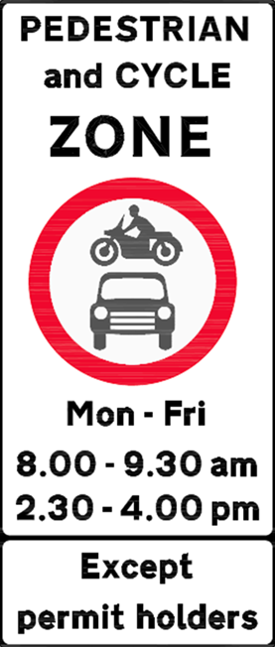
Pedestrian zone pilots
June 2017 – Pilot proposals developed
Sept 2017 – Pilots operational
Sept 2017 – Consultation begins
March 2018 – Consultation ends
May 2018 – Council elections
July 2018 – Council confirms scheme
Notes:
Schools, parents, residents, police, ward cllrs

Slide 4
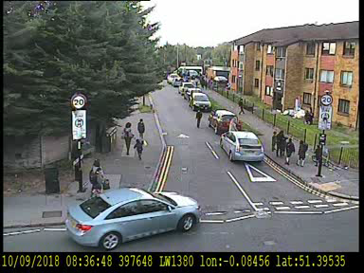
How the pilot worked
Not physically preventing vehicles from entering zone
Monitoring through unattended CCTV cameras at entry providing continuous presence
Vehicles entering zone at restricted times trigger creation of video
Each file is manually Reviewed by enforcement team to approve or reject
Operated initial one month acclimatisation period where no PCNs issued
Example of file created for officer review
Notes:
On street enforcement impractical
Eric Pickles
Zig zag infringement only
If approved Penalty Charge Notice (parking ticket) issued with a fine £130, reduced to £65 paid within 14 days
Total PCN income = £266,645

Slide 5
The pilot - outcomes
Considerably better results than anticipated
 | Active Travel (walk, scoot, cycle) |  | Public Transport |  | Car
SCHOOL | 2017 | 2018 | 2017 | 2018 | 2017 | 2018
Woodcote | 29% 209 | 47% 347 | 4% 26 | 2% 14 | 68% 491 | 51% 371
Heavers | 53% 363 | 65% 449 | 14% 93 | 9% 60 | 34% 231 | 26% 181
St Chads* | 32% 123 | 46% 144 | 20% 78 | 23% 71 | 48% 184 | 32% 100
Notes:
St Chads 2016 survey results instead of 2017

Slide 6

Other benefits
  Modal shift towards methods of active travel
  Improved punctuality with drop in pupil lateness
  Large reduction of vehicles outside schools at peak times
            Decreased levels of emissions outside school gates
  Healthier, more active pupils and visitors
  Reduced risk of accidents
  Improved air quality around the school site
  Increase in the school’s reputation

Slide 7



Award winning
….it has also been recognised across service sectors and has received the following awards…
Notes:
LRSC conference case study

Slide 8
Not universally popular
Displacement of school parents into surrounding roads
Deemed less safe by some parents for children to walk to school rather than be driven
Penalising families where both parents work
The distance some parents live from school means that they have no choice but to drive
…in violation of parents and residents human rights!
Notes:
Legal challenge

Slide 9
Proposal to Extend The Scheme
Three new schools a year
Clear criteria to identify appropriate locations
Borough wide policy on operation of schemes
Appropriate exemptions
Informal and formal consultation prior to start
Starts September 2019
Notes:
Location criteria
Physical location
Compatible with camera enforcement
School support
Councillors support
Exemptions
Residents
Visitors to residents
School staff
Parents with specific requirements/needs

Slide 10
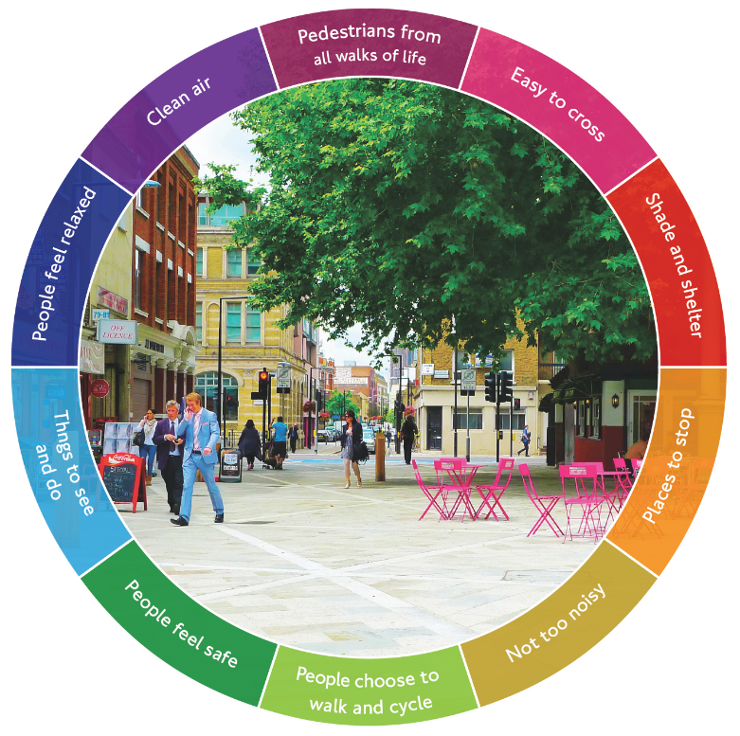
Healthy Schools Network
Will work along side the Healthy schools network zones,
This policy puts people and their health at the centre of our decision making, helping everyone to use cars less and to walk, cycle and use public transport more.
It works alongside the 10 Healthy Streets Indicators to help you think about the issues that affect the experience of using a street and spending time there.
Notes:
LIP3
Area wide approach alongside other activities/actions

