Slide 1
LONDON ROAD SAFETY COUNCIL: FACING THE FUTURE OF ROAD SAFETY EDUCATION IN LONDON
CURRENT AND FUTURE ROAD SAFETY EDUCATION, TRAINING AND PUBLICITY PROVISION ACROSS THE 33 LONDON LOCAL AUTHORITIES

Slide 2

The London Road Safety Council is grateful for the support of The Road Safety Trust in this project.
Raising Road Safety awareness and sharing knowledge and learning
Supporting the development of evidence based approaches to Road Safety
Improving Road Safety policy and practice
Encouraging partnership working

Slide 3
Aims and objectives of the project:
1) In the context of reductions in local authority spending, to develop a London-wide picture of:
current road safety provision
aims and aspirations for the future
concerns individual boroughs have about the future
barriers and challenges

Slide 4
To disseminate results of the research project and recommendations for the future through:
* report for distribution to all stakeholders
* mini conference to report on the first phase of the research
* 2nd conference to report on the completed project and to disseminate good practice identified,
To share plans for future LRSC support through:
* the website
* provision of training for members and a forum for discussion
* campaigns

Slide 5
Project research design and methodology
90 minute interviews with all London Local Authorities, meeting:
Elected Members with road safety portfolio
Head of Service
Road Safety Manager
Stage 1:
Initial preliminary interviews with 6 authorities to test process
Stage 2:
Interviews with remaining 27 authorities and with Transport for London

Slide 6
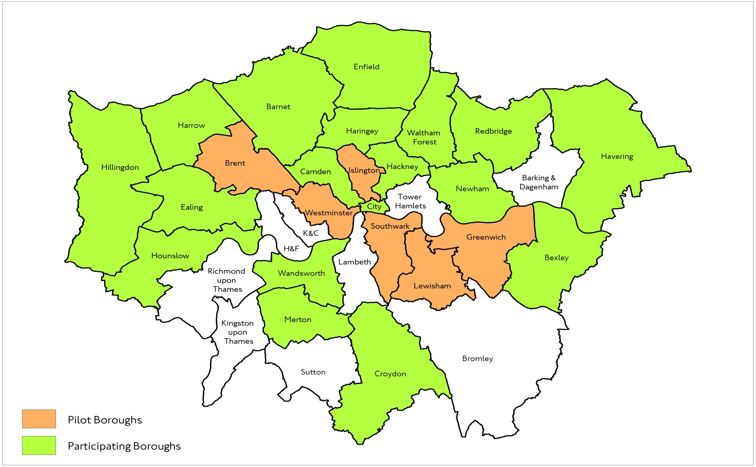
PARTICIPATING BOROUGHS

Slide 7
Local Authorities’ Interview
Demographics schools and political complexion
The road safety issues they identified in their borough.
Changes in their road safety team from 2010 to 2017
Funding of the service.
Partnership working.
Elected members: road safety champions and relationship with LRSC.
How the future for road safety was seen:
its continued importance to their borough
the future of the service
future changes to maintain priority of the service.

Slide 8
Transport for London Interview
About the organisation and its support for boroughs
Road safety issues
TfL funding and funding for local authorities
TfL priorities for the future for road safety in London
Notes:
Road safety issues: casualty data, differences between boroughs, campaigns and interventions, Vision Zero
Funding: sources of funding, criteria for borough funding
The future for road safety: TfL priorities, funding reductions in London Boroughs, Anticipated changes to maintain priority of London RS.

Slide 9
Interviews carried out with 25 London local authorities between January and March 2018. Timescale driven by the context of local authority elections.
In all cases staff with responsibility for road safety were interviewed, and in most cases managers and elected members took part.
We were able to identify examples of good practice in the context of reduced funding for road safety.
There were also concerns arising from these interviews.
We are very grateful for the cooperation and help we have received from the London Local Authorities with this project.

Slide 10
Boroughs’ Chief Concerns
f
Funding Cuts
Outsourcing of provision
Reductions in Staff Nos
Cuts to services
Movement to new teams and functions
Loss of knowledge & experience

Slide 11
FINDINGS

Slide 12
Reduced Funding
LIP funding is constant but no longer ring fenced
Some Boroughs are committed to maintaining staffing levels
Others are not!

Slide 13
Staffing Levels
Some Boroughs have maintained levels
Some have cut significantly
Many have changed roles and titles leaving like-for-like comparisons difficult
Some were less than transparent with the review team

Slide 14
Staff Capability
Some excellent staff deployed on work which includes road safety
Fewer staff with dedicated road safety roles
Less time available for networking
A smaller pool to recruit from outside London as well as within – a problem for the future?

Slide 15
Common Threads
Traditional ETP work
Speeds
School Streets
Air Quality
Motorcycling
Data
Outputs vs Outcomes
Evaluation
Working with business

Slide 16

London Boroughs
Camden
Hackney
Lambeth
Lewisham
Newham
All have issues with riders on motorcycles up to 125cc

Slide 17
Residents verses roads
Need to understand who is crashing on local roads:
Non-residents – how to access to engage with them
Residents crashing elsewhere – responsibility to local residents
Collaboration with neighbouring & similar Boroughs
London-wide campaigns & interventions
Use of postcode data to understand how to access target audience

Slide 18
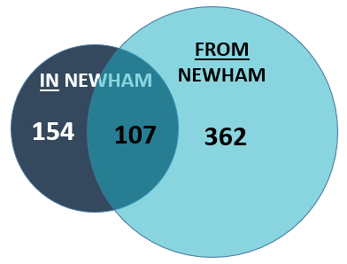

Newham – residents crashing elsewhere

Slide 19
Hackney – residents & Roads
325 riders residing in neighbouring boroughs crash in Hackney
178 riders residing elsewhere in London crash in Hackney
169 riders of unknown residency
77 riders residing outside London crash in Hackney
213 Hackney resident riders crash in Hackney
Number of involved riders by residency and collision location
2012 to 2016
Objects to correct relative scale
17 Hackney resident riders crash outside London
241 Hackney resident riders crash in neighbouring boroughs
118 Hackney resident riders crash elsewhere in London

Slide 20
Rush hour peaks

Slide 21
Newham – evening peak

Slide 22
The Future?
Data needs addressing – other sources of risk information?
Outcomes vs Outputs?
Blank sheet programme development?
Collaborative working?
Evaluation and Research?
Profile of Road Safety?

Slide 23
Questions?

