Slide 1
LRSC
21st July 2017
Nick Lloyd
Road Safety Manager

Slide 2

RoSPA
The Charity was founded in London in 1917 due to a rise in pedestrian casualties
Notes:
Introductions
Briefly about RoSPA
Founded in 1917 originally as the London Safety Council to tackle rise in pedestrian deaths. Centenary – HRH Prince Andrew
Received Royal Patronage and became Royal Society for the Prevention of Accidents 1941
Continue to be the leading safety charity in UK (Roads, Industry, Water & Leisure)
Today I will be talking about animal collisions (focussing on deer) and what can we do about preventing it.

Slide 3
Road Traffic Unintentional Injuries to children and young People
In my presentation I will cover:
Current and immediate past work of RoSPA
Public Health England data sets
Notes:
In my presentation I will firstly look at national and local data from the SE to see what it is telling us (This will be fairly brief as being data analysts you will be familiar with this – however, it will help to put things into context)
I will then consider what preventative options are available at our disposal to make the roads safer for children and young people.
Q. Do you think the roads are getting safer?
Q. Safer for who?

Slide 4
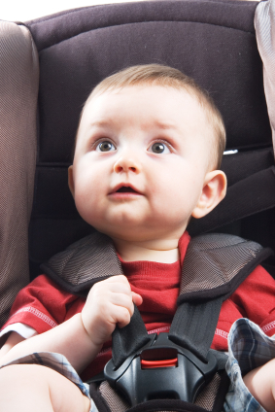

RoSPA Work – Child Car Seats
Child car seats - website www.childcarseats.org.uk
Producing a new information film
New training package
Notes:
Child car seat website – one of our most popular information sites with 2 million views pa.
New information film
New training package – for RS Professionals. Free download, including new film clips

Slide 5

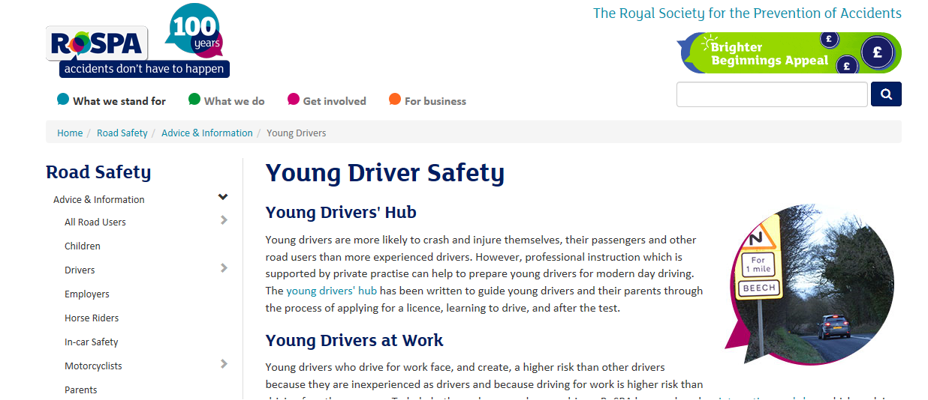
RoSPA Work – Younger Drivers
Young drivers hub
Young drivers at work - workshop
DfT young driver project
Notes:
Young drivers hub – pre, during and after their test
Young drivers at work
-Develop their knowledge about specific driving for work issues
-Gain insight about what influences their driving
-Understand how they can develop coping strategies for driving for work
-Share experiences and learn from each other.
DfT have started a research project looking at what interventions are most effective with young drivers. RoSPA is one of the partners

Slide 6
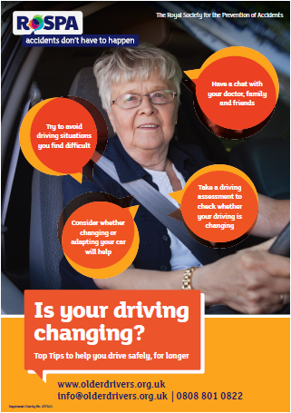

RoSPA – Older Drivers
Older drivers website
Older drivers resource for GP
www.olderdrivers.org.uk

Slide 7

RoSPA Work - Evaluation
Road safety evaluation – E-valu-it ‘Webcasts’
www.roadsafetyevaluation.com
Notes:
Last year we updated the E-valu-it RS evaluation website, it now includes a series of 11 webinars that talks you through the evaluation process.
Data is the key to evaluation – of which there is some really good data available which you may not be familiar with from PHE

Slide 8
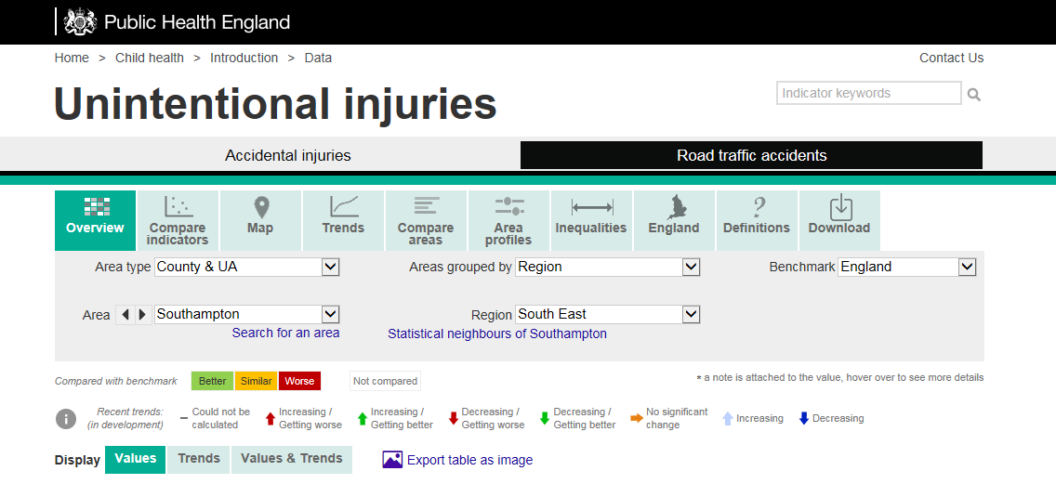
https://fingertips.phe.org.uk/profile-group/child-health/profile/child-health-injuries
Notes:
This is the front page and here is where it can be accessed.
CLICK

Slide 9
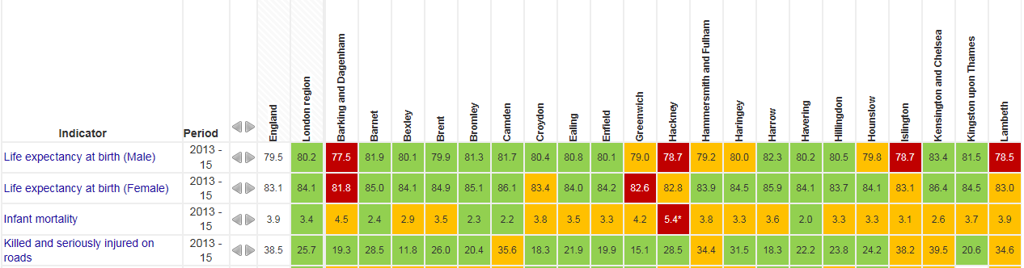
PHE Health Profiles – Over View 2013-15 London
England
38.5
London
25.7
Islington
38.2
Compared to bench mark authorities;
Green = better, Yellow= similar, Red = worse
Notes:
The KSI rate is the one we would be interested in.
CLICK
England 38.5
London 25.7
Islington 38.2

Slide 10
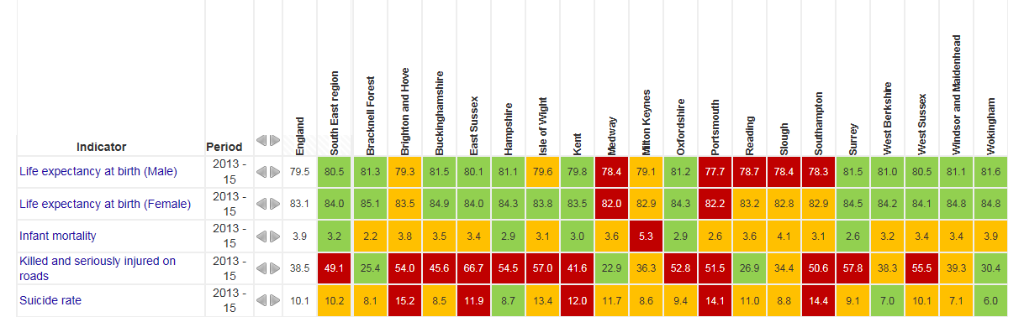
PHE Health Profiles – Over View 2013-15 SE Region
Notes:
The KSI rate is the one we would be interested in.

Slide 11
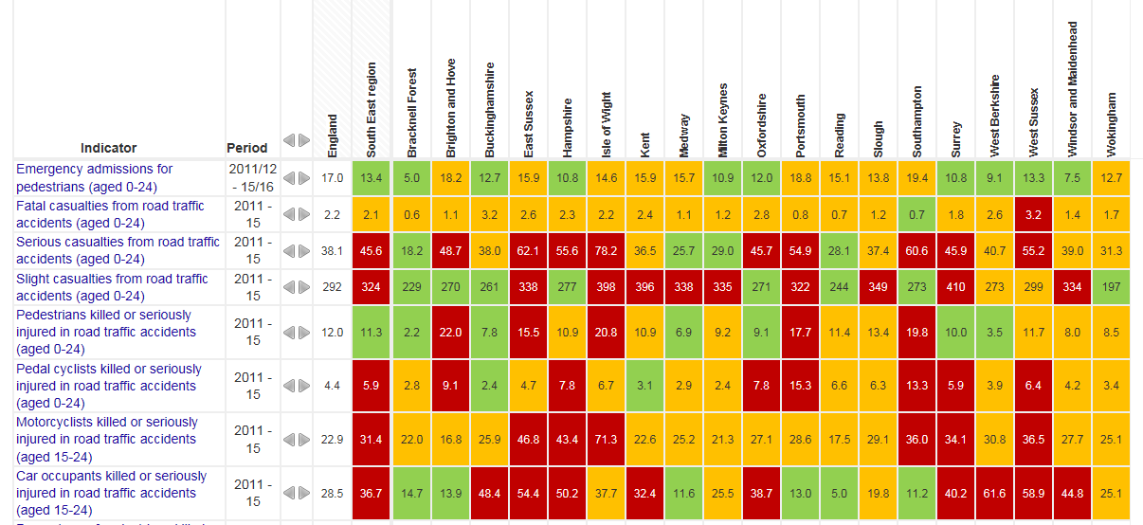
PHE Data Charts: Road Traffic Accidents (Over View)
Notes:
This chart breaks down the information :
Using the Southampton example again you can see how the LA is comparing to England and the SE Region per 100,000 casualty rate.
Performing worse for vulnerable road users (pedestrians, cyclists and motorcyclists)

Slide 12
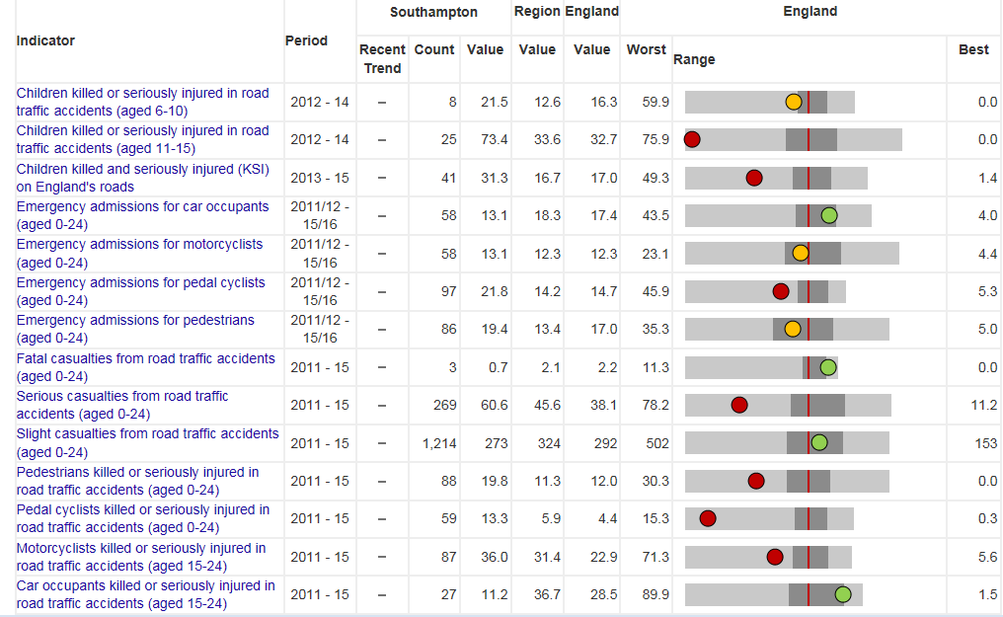
PHE Data Charts: Road Traffic Accidents (Area Profiles)
Notes:
Again shows poor performance for vulnerable RU
Count= actual numbers
Value = extrapolated data per 100,000

Slide 13
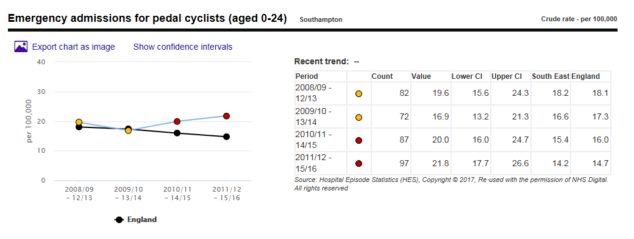
PHE Data Charts: Road Traffic Accidents (Trends)
Notes:
If you want to look at the situation in more detail you can go to the Trend charts and choose an indicator. Eg Emergency Admissions for pedal cyclists aged 0-24. It would be interesting to compare this to the stats 19.
This table cross references to the over view one previously shown.
21.8 emergency admissions per 100,000 compared to SE 14.2

Slide 14
Child RTC in Southampton
2010-14
av 2011 2012 2013 2014 2015 % change
Killed 0 0 0 0 0 0 0
KSI 14 19 12 12 16 13 -10
All 81 92 70 64 90 67 -17
RRCGB 2015
Notes:
This is taken from RSGB 2015 (Table) – Looking at this it would not set off too many alarm bells ringing. Fairly consistent, with 10% reduction in child KSI in Southampton based on the 2010-14 av.
However, when we look at the Public Health Profile Data for Child KSI for SE Region this is what we see:

Slide 15
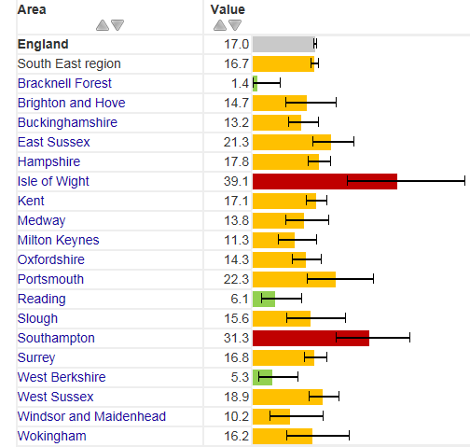
Child KSI 2013-15
Notes:
This shows that Southampton during the period 2013-15 is performing worse when compared to both England and the SE Region.

Slide 16
Casualties in Southampton
2010-14
av 2011 2012 2013 2014 2015 % change
Killed 2 2 1 4 1 3 36
KSI 127 154 110 123 124 125 -1
All 780 817 777 709 812 683 -12
RCGG 2015
Notes:
Useful to use in conjunction with this chart so see how you are doing compared to the other authorities in your area that are similar.
For Southampton the KSI picture looks ok when using STATS 19 data

Slide 17
PHE Health Profiles – Over View 2013-15
Notes:
But not so good on this:
KSI rate per 100,000 for Southampton is 50.6, compared to SE 49.1 and England 38.5

Slide 18
Thank you
Nick Lloyd – Road Safety Manager
nlloyd@rospa.com t. 0121 248 2078
Notes:
Thank you.

